Slide 1
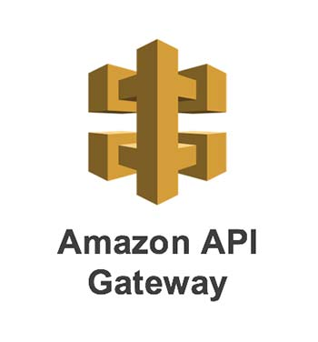

Slide 2

Topics
What is API Gateway
What it can do
Exam Tips

Slide 3

What is API Gateway
API Gateway is a fully managed service that makes it easy for developers to publish, maintain, monitor and secure APIs at any scale.
With a few clicks of AWS management console, you can create an API that acts as a "front door" for applications to access data, business logic or functionality from your backend services such as applications running on Amazon EC2, code running on AWS lambda or any web application.

Slide 4
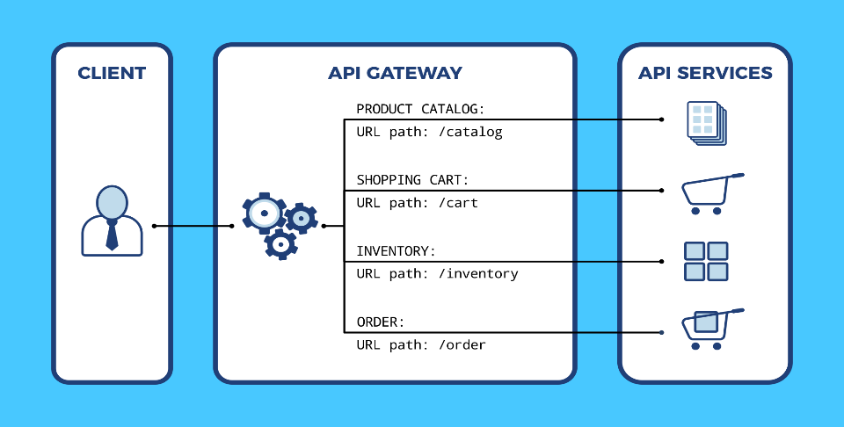
API Gateway

Slide 5
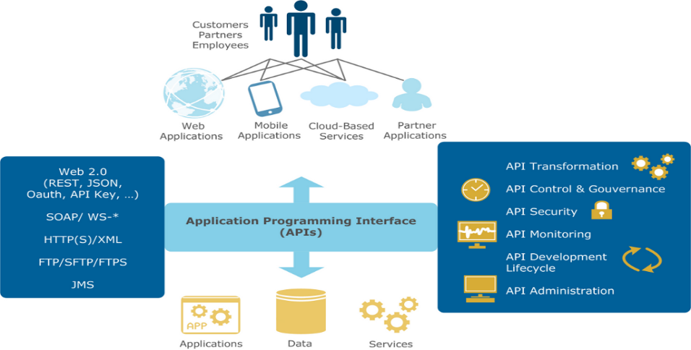
API Gateway

Slide 6
What it can do
Expose HTTPS endpoints to define a RESTful API.
Serverless-ly connect to services like lambda and DynamoDB.
Send each API endpoint to a different target
Run efficiently with very low cost.
Scales effortlessly
Track and control usage by API key
Throttle requests to prevent attacks
Connect to CloudWatch to log all requests for monitoring
Maintain multiple versions of your API

Slide 7
How you configure it.?
Define an API (container)
Define the Resources and nested Resources (URL paths)
For each resource:
Select the supported HTTP method.
Set security
Choose targets(such as EC2, Lambda, DynamoDB, etc)
Set requests and response transformations.

Slide 8
How to deploy API Gateway?
Deploy API gateway to a stage
Uses the API Gateway domain by default
Can use a custom domain name
Now supports AWB Certificate Manager: free SSL /TLS certificates

Slide 9
API Gateway Caching
You can enable API caching in API gateway to cache your endpoints response. With caching you can reduce the number of calls made to your endpoints and improve the latency of request to your API.
When you enable caching for a stage, API Gateway caches responses from your endpoints for a specified time-to-leave (TTL) period, in seconds
API Gateway then responds to the request by looking up the endpoint response from the cache instead of making the request to your endpoint.

Slide 10
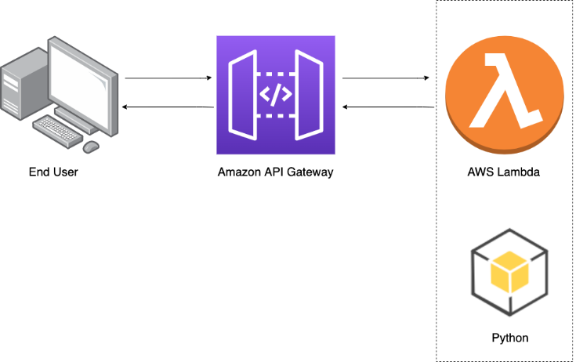
API Gateway Caching

Slide 11
Same origin policy
In computing, the same-origin policy is an important concept in web application security model. Under the policy, a web browser permit scripts contained in a first web page to access data in a second web page but only if they both have the same origin.
This is done to prevent Cross-Site Scripting (XSS) attacks
Enforced by web browsers
Ignored by tools like postmen and curl

Slide 12
CORS
CORS stands for cross origin resource sharing and CORS is one way the server at the other end (not the client code in the browser) can relax the same-origin policy
Cross-origin resource sharing (CORS) is a mechanism that allows restricted resources (e.g. fonts) on a Web page to be requested from another domain outside the domain from which the first resource was served.
Browser makes a HTTP OPTIONS call for a URL (OPTIONS is HTTP method like GET/PUT/POST)
Server returns a response that says "These are the other domains are approved to get this URL"
Error - "Origin policy cannot be read at the remote resource" You need to enable CORS on your API gateway.

Slide 13
Exam Tip
API Gateway has caching capabilities to increase performance
The API Gateway is low cost and scales automatically.
You can throttle API gateway to prevent attacks.
You can log results to cloud watch
If you're using JavaScript or Ajax that uses multiple domain names with API Gateway, enable or ensure that you have enabled CORS on the API gateways
CORS is enforced by the client.

Slide 14
Thank you

